Slide 1


SMART RECRUITMENT ASSISTANT
Problem Statement:- Recruiters spend excessive time screening resumes and matching candidates with job descriptions. Manual shortlisting is slow and inconsistent.
Recruiters spend excessive time screening resumes and matching candidates with job descriptions. Manual shortlisting is slow and inconsistent.
Manual screening is slow, inconsistent, and biased.
High volume of applicants makes efficient hiring almost impossible.
TECH TITANS

Slide 2

Proposed Solution
Smart Recruitment Assistant reads and analyzes job descriptions & resumes using AI.
Uses LLM-based matching to rank candidates.
Provides Top N recommendations automatically.
Sends personalized shortlisting emails.
TECH TITANS

Slide 3

Key Feature
✅ Resume & Job Parsing
✅ AI Candidate Scoring
✅ Automated Email Shortlisting
✅ Recruiter Dashboard (React UI)
TECH TITANS
Rao.SBK

Slide 4
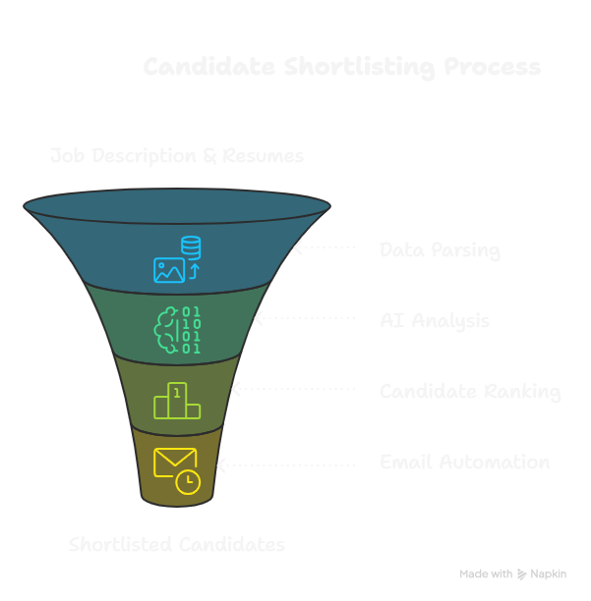
System Architecture
TECH TITANS
Rao.SBK

Slide 5
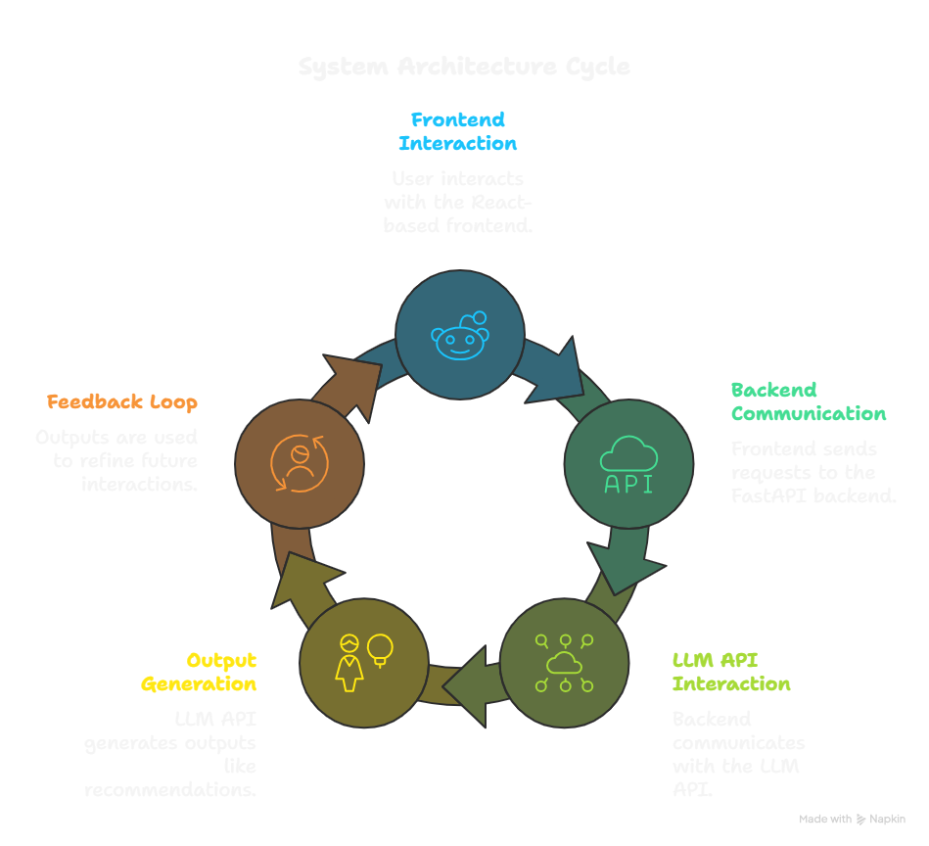
Tech-Stack
TECH TITANS

Slide 6
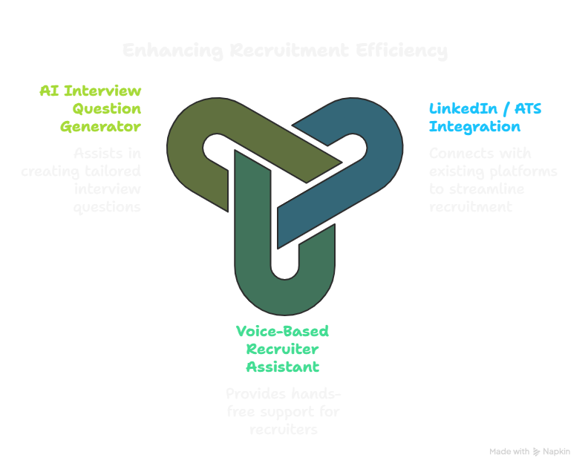
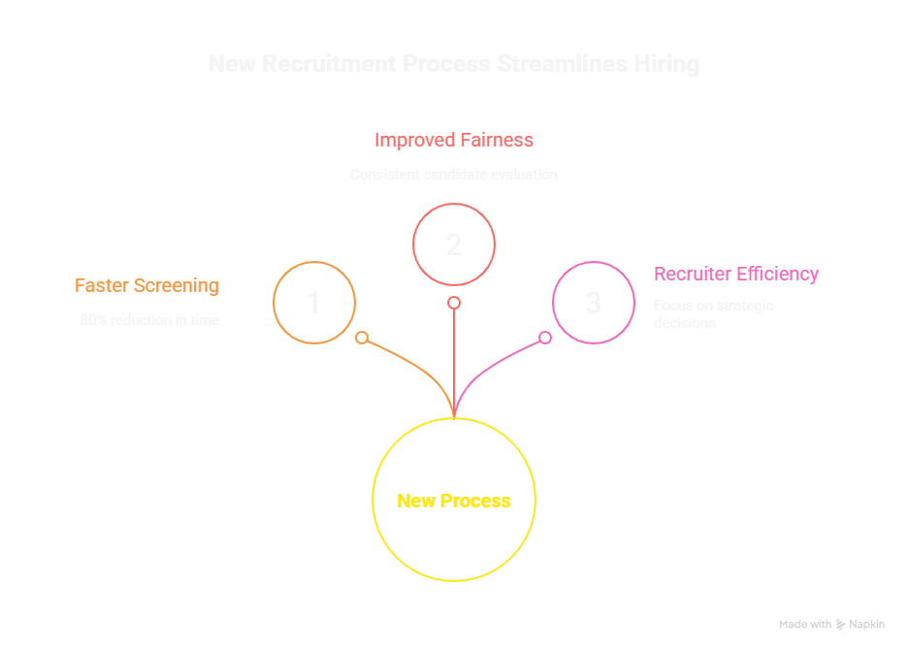
Future Scope
Impact
TECH TITANS

Slide 7
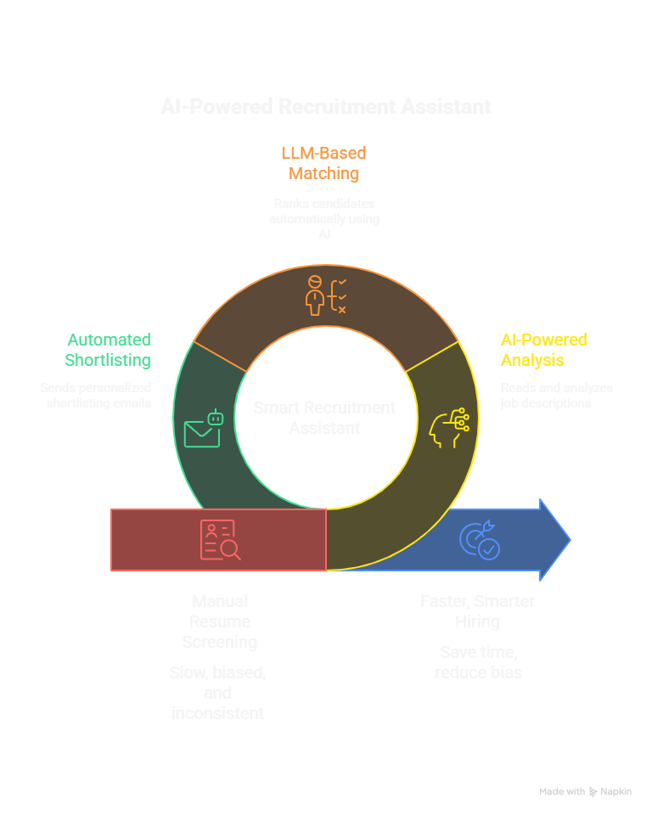
Conclusion
TECH TITANS
Rao.SBK

Slide 8
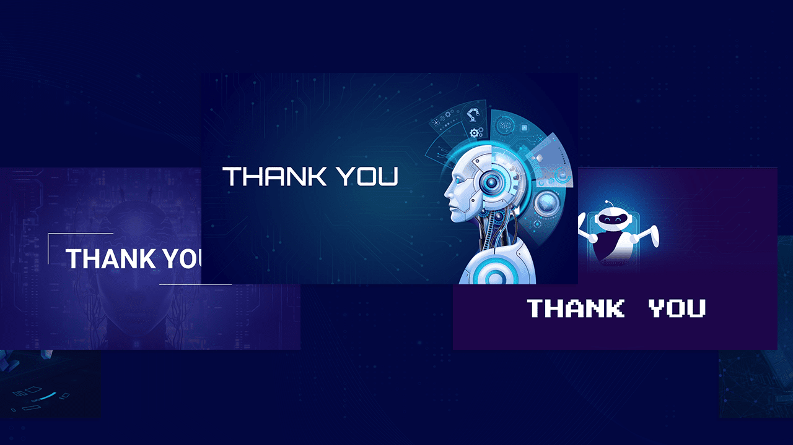
TECH TITANS

